Slide 1
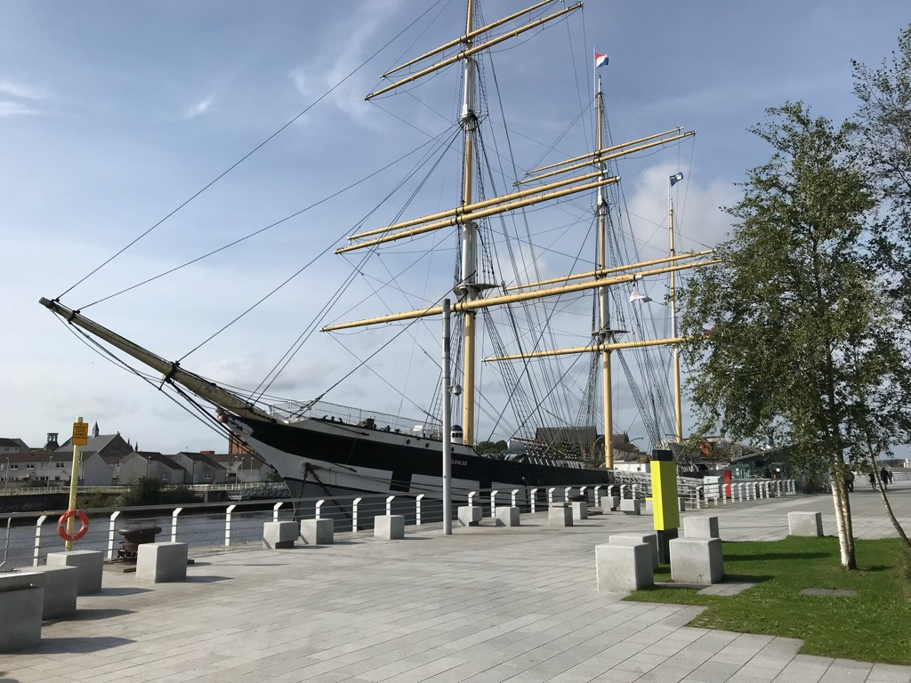
The Tall Ship Glenlee Visual Story

Slide 2
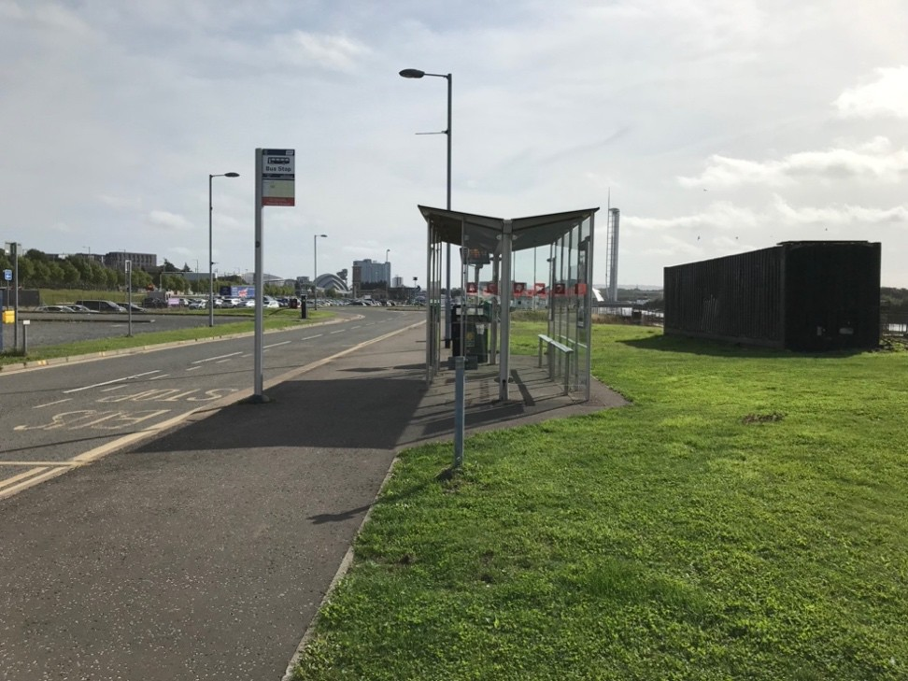
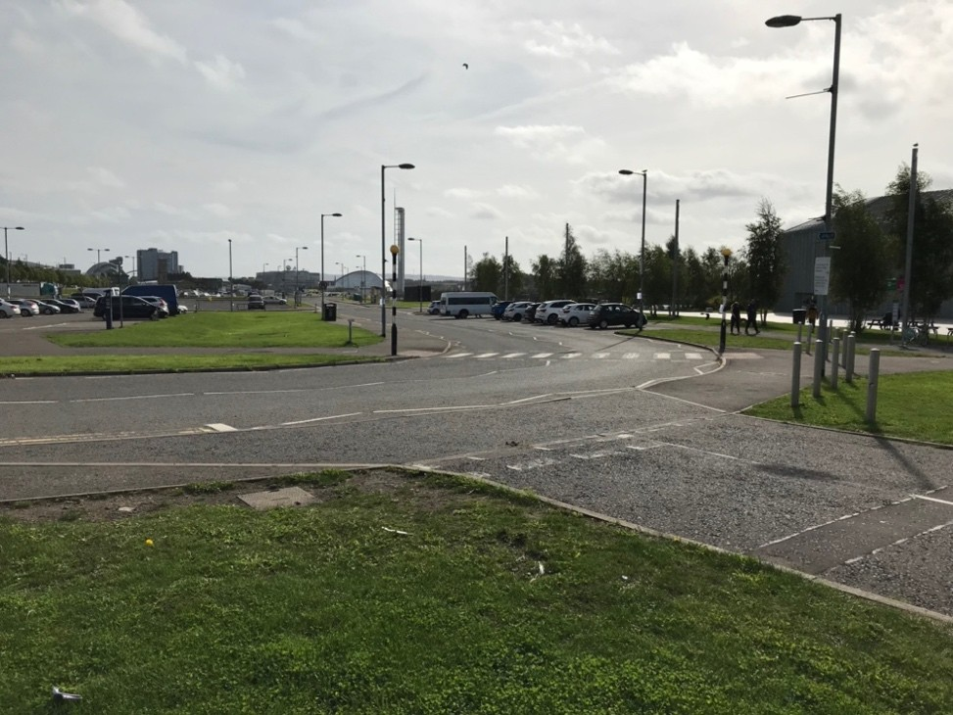
When we arrive
We can arrive by bus or car.
There is a car park in front of the Riverside Museum.

Slide 3
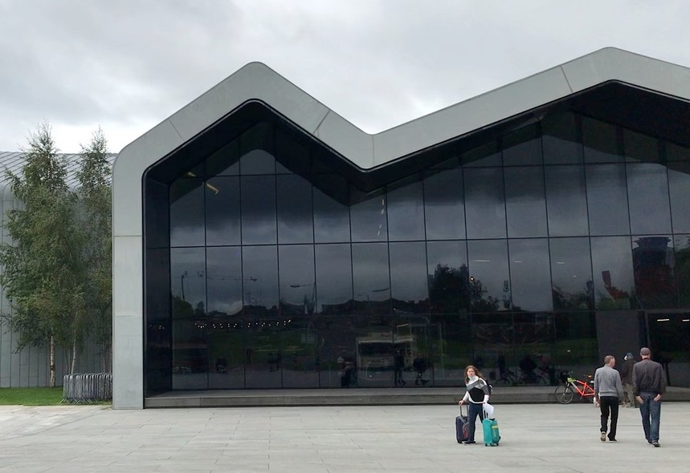
When we arrive
We can walk through the Riverside. Museum to The Tall Ship.
We can walk around the side
of the museum to The Tall Ship.

Slide 4
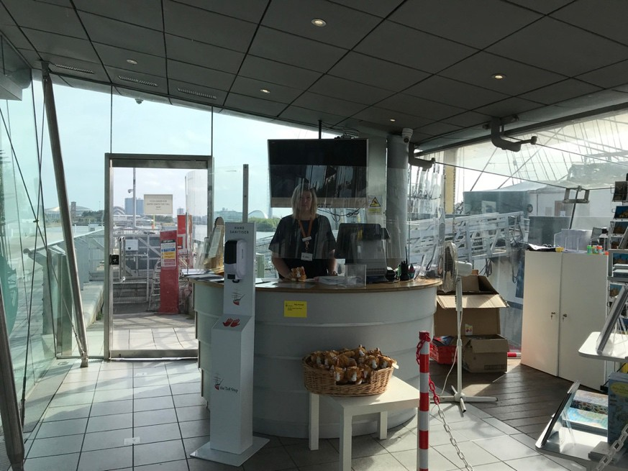
The pavilion
First, we will go through the entrance. Someone might be there to meet us.
A member of staff will give us information about our visit.
We must stay with our leaders at at all times.

Slide 5
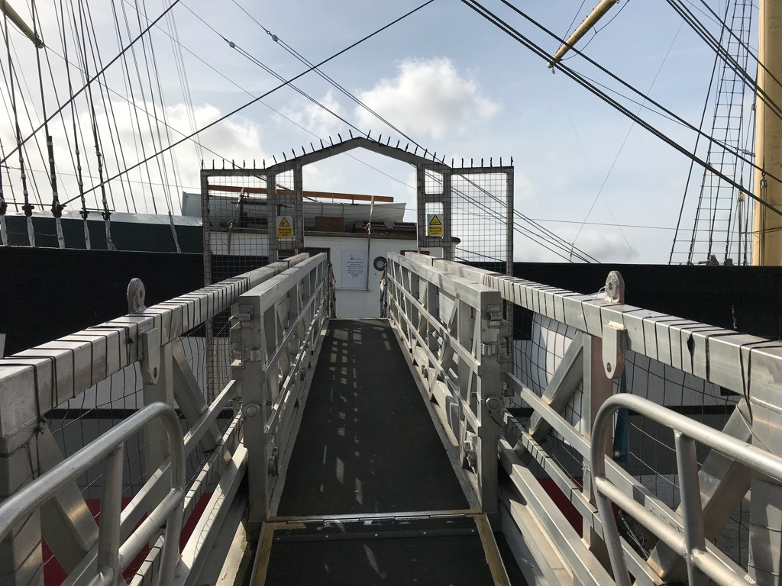
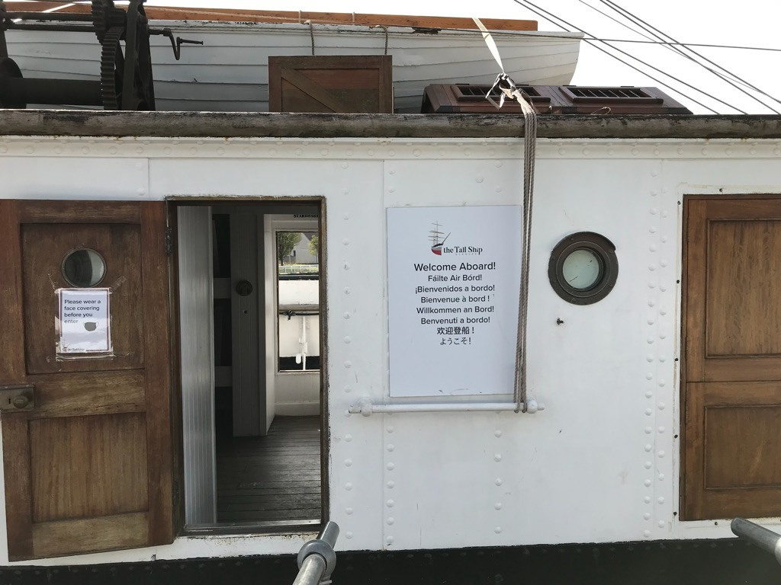
Going onboard
We will go up a ramp to get on the ship. It might be steep.
The deckhouse is the first thing you will see. You will have to step over a lip to enter.

Slide 6
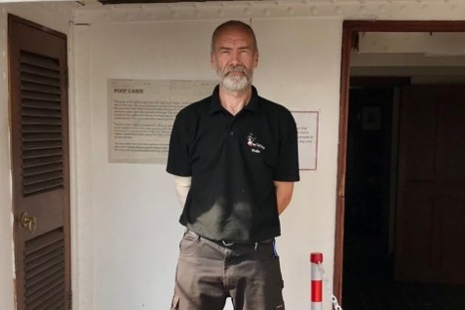
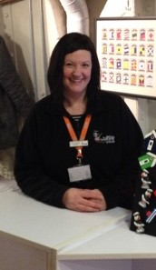
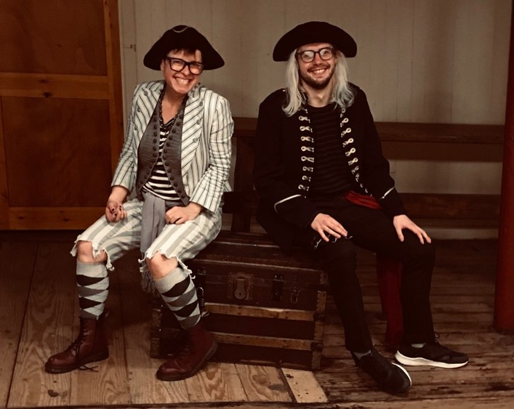
People who can help us
Staff will wear a badge or a lanyard and will be wearing a black uniform.
There might be staff who are dressed in costume.
The crew may be working in areas of the ship and you may not be able to enter these places.

Slide 7
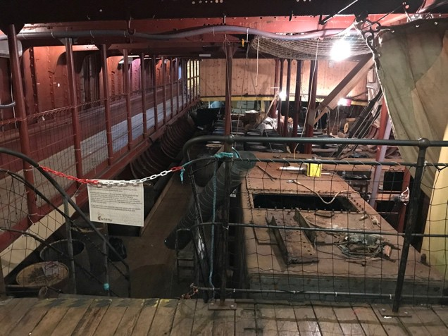
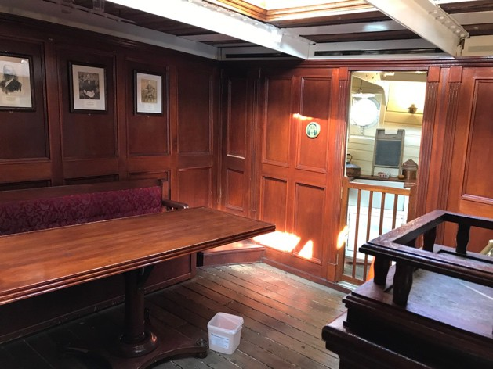
Onboard the ship
There are areas in the ship that are dark and noisy.
There may be unusual smells in
some places.
There are places in the ship that are very confined and might have a lot of people inside.

Slide 8
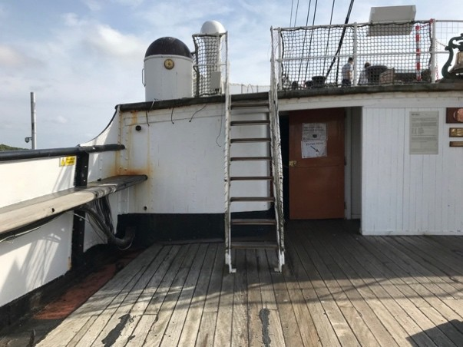
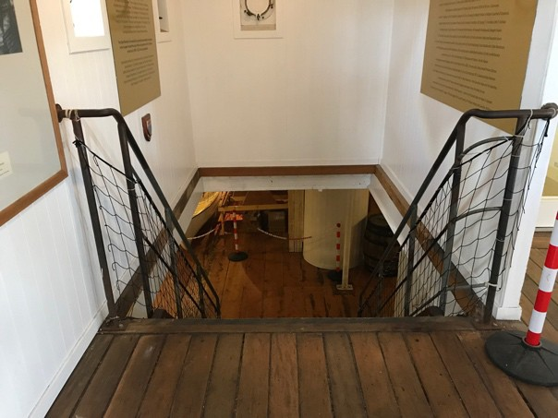
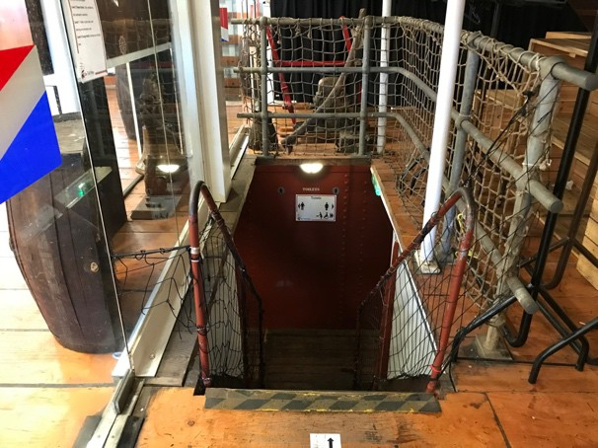
Getting around the ship
There are a lot of steep and narrow stairs outside and inside the ship. Please be careful. There is a lift onboard if you need it.
If you hear an alarm a member of staff will help you.

Slide 9
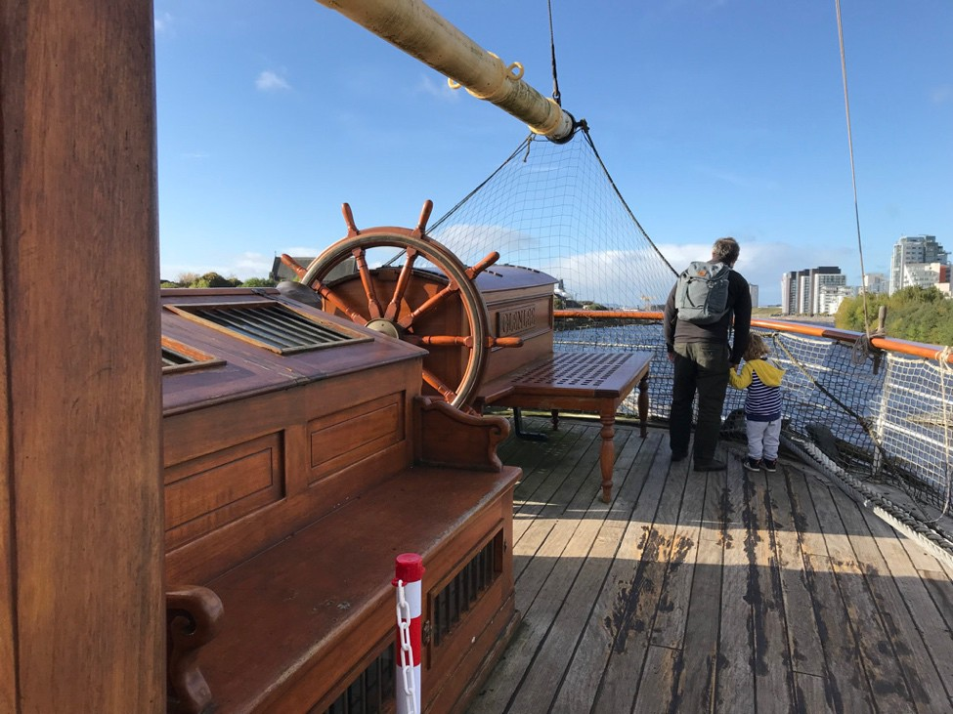
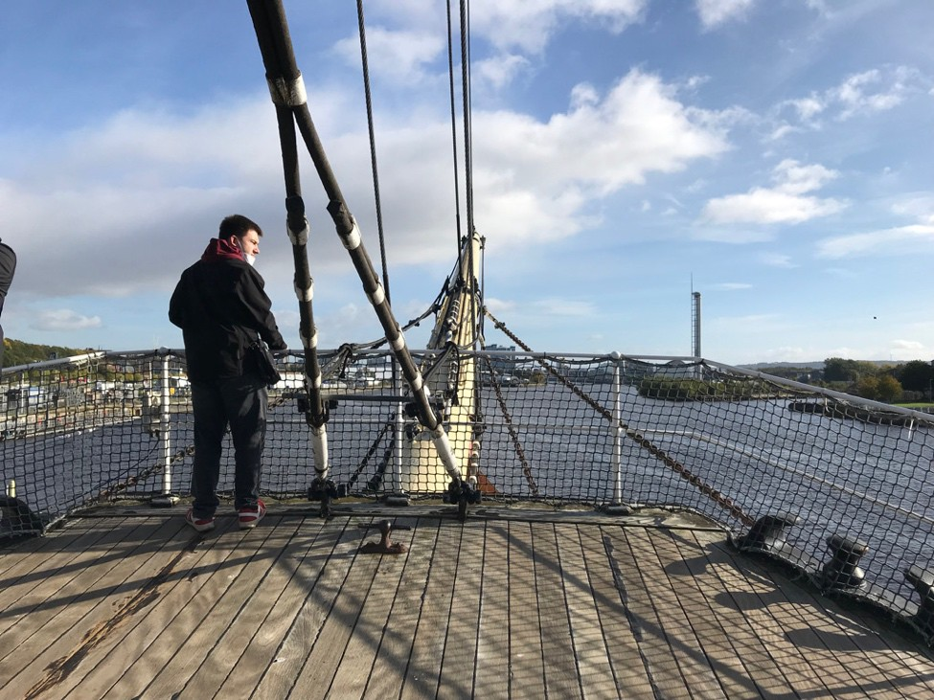
Getting around the ship
At the front and back of the ship there are areas that are higher up. Please be careful here.

Slide 10
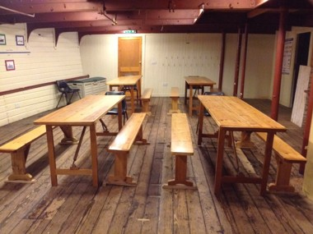
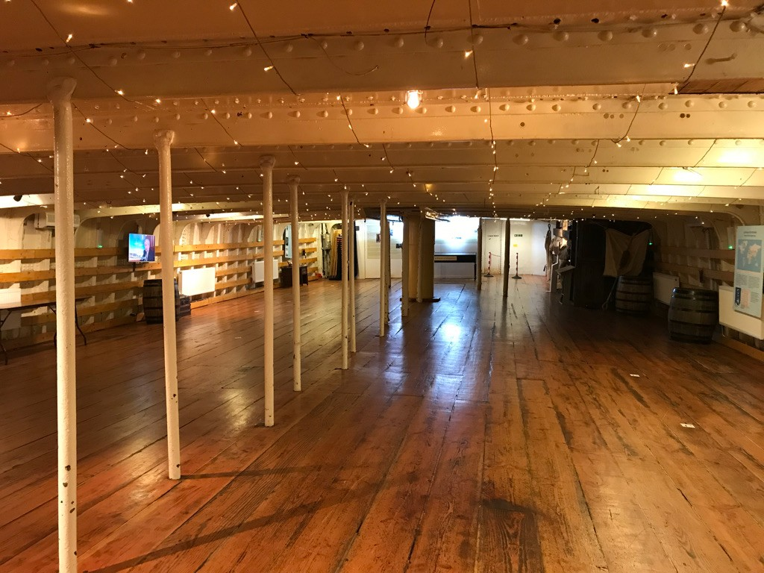
Visiting with a school or nursery
If we are visiting with a school or nursery we may have our workshop and lunch in the education room or on the tween deck.

Slide 11
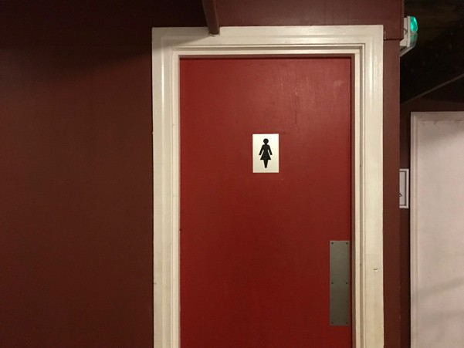
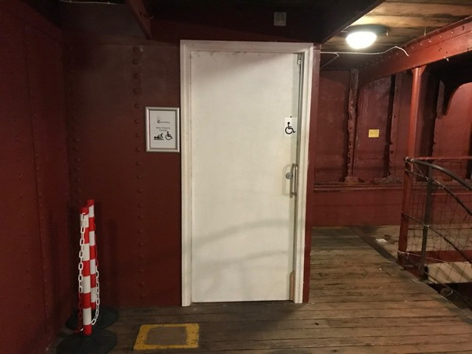
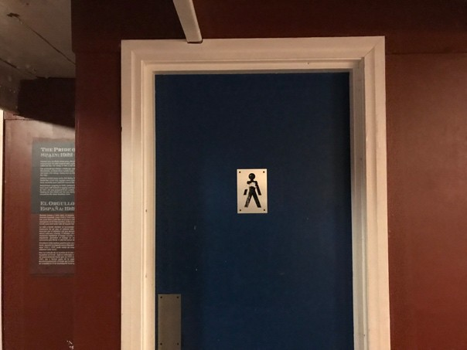
The toilets
The toilets are located down the stairs in front of the café entrance. There is an accessible toilet and baby changing facilities there also.

Slide 12
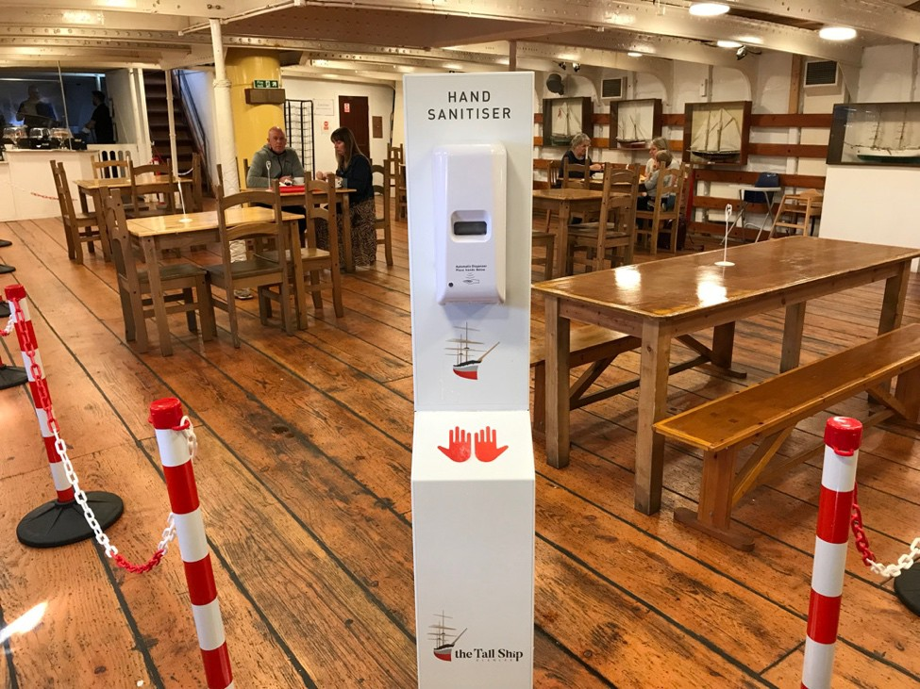
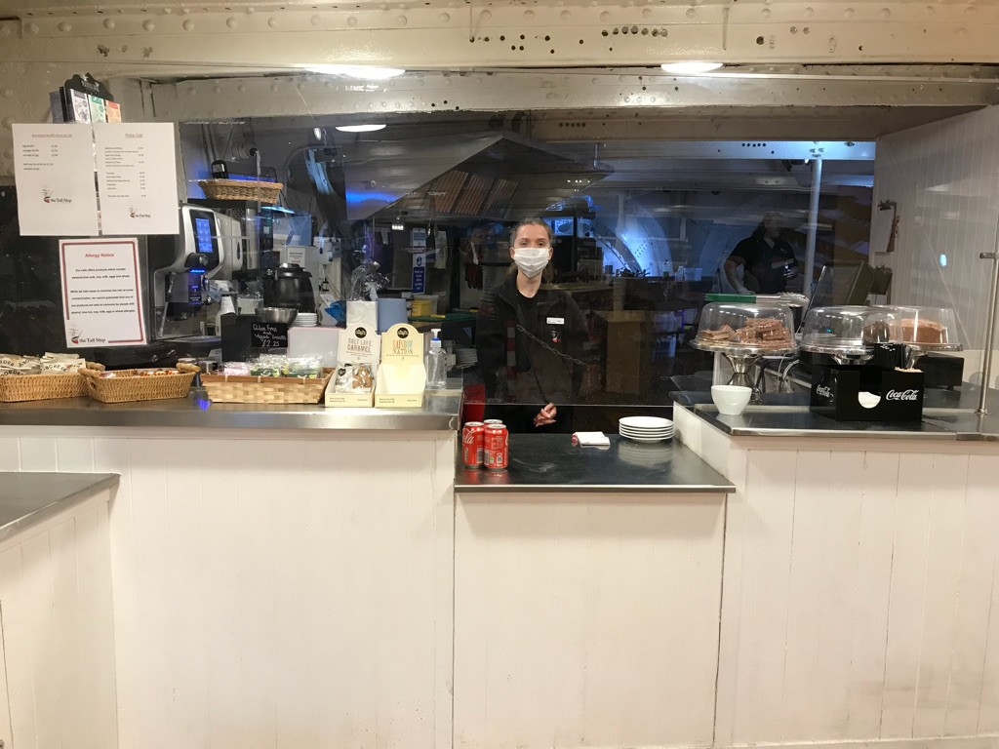
The cafe
The café is at the back of the ship on the tween deck. You can order food and drink at the counter.

Slide 13
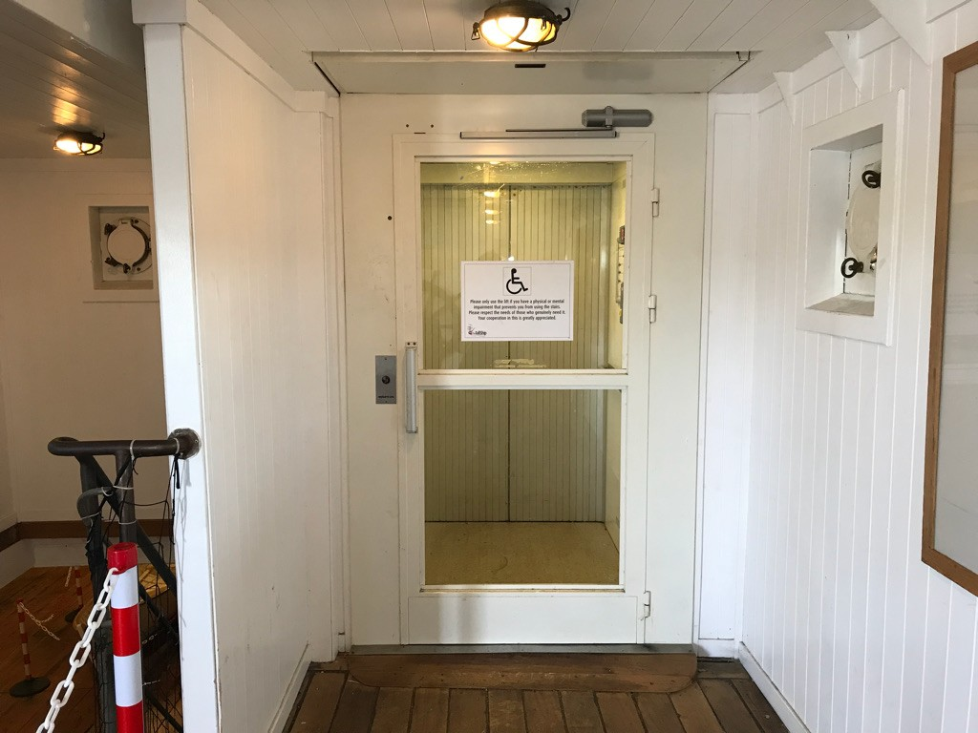
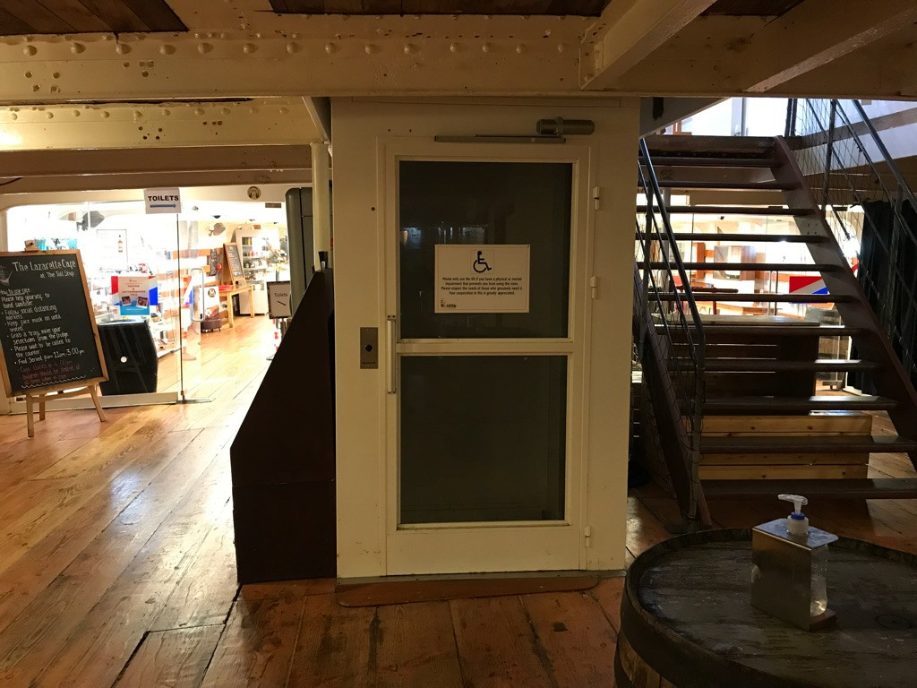
The lift
There is a lift that goes to all floors, press the button on the left to call it.

Slide 14
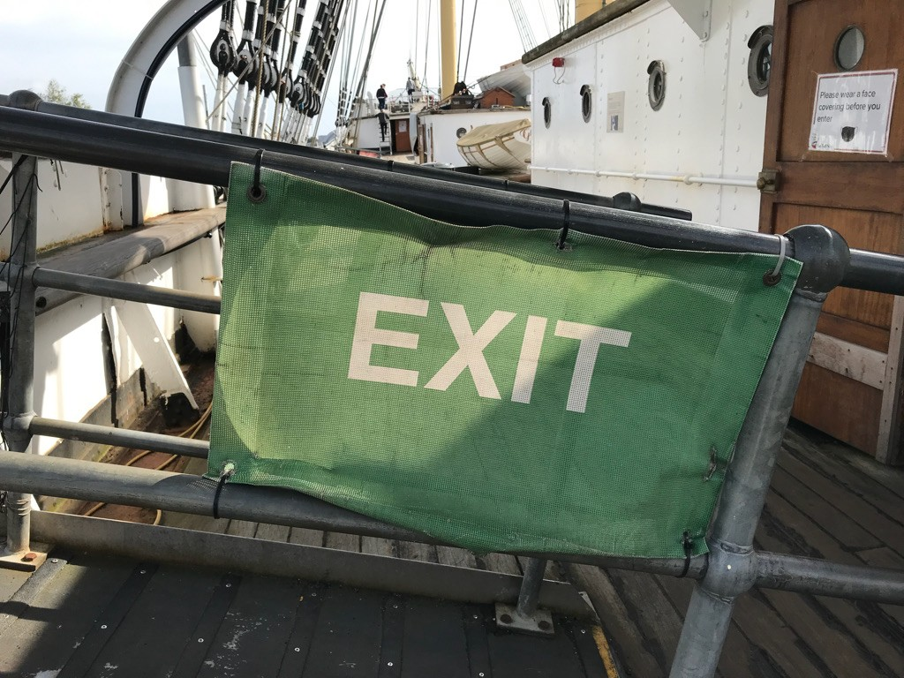
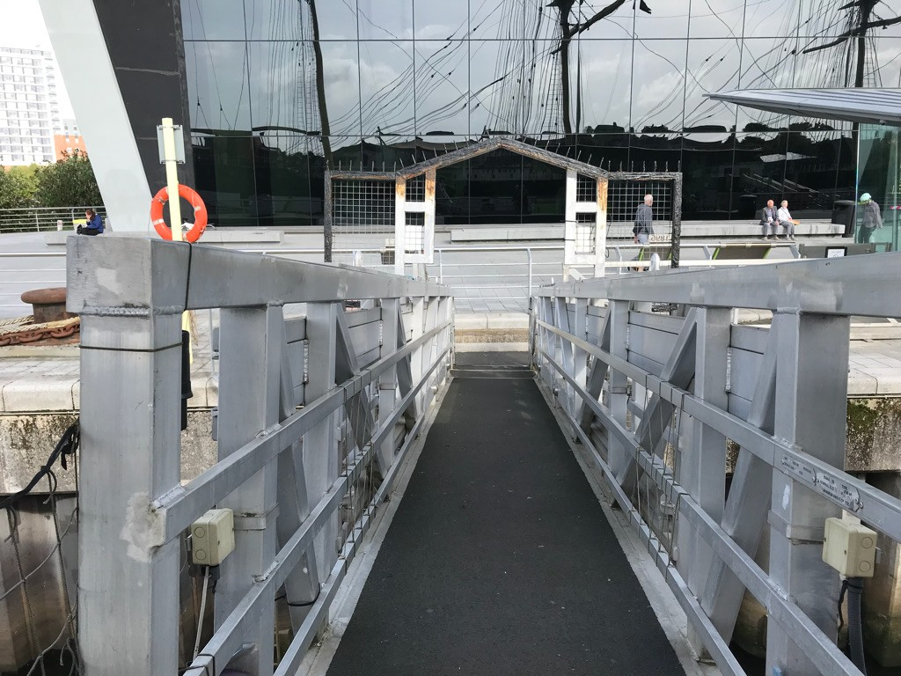
When we leave
When it is time to leave the ship, look for the exit sign. The ramp may be steep.

Slide 15
If you require specific access or educational needs please call 0141 357 3699 and ask to speak to the Learning and Access Team.
The Tall Ship Glenlee 150 Pointhouse Road, Stobcross Road, Govan,
GLASGOW G3 8RS.
Tel: 0141 357 3699
Email: learning@thetallship.com
Website: https://thetallship.com

